Slide 1
Data Sciences
Yogesh Kulkarni

Slide 2
Agenda: - What are Data Sciences? - Preparing for Career in it

Slide 3
What are Data Sciences?
ie What is Artificial Intelligence? Machine Learning? Deep Learning?

Slide 4
“Houston, we have a problem!!”

Slide 5
The Problem
Every company is claiming to be working in AI-ML
Is it so?
What exactly is AI (ML)?
What is not AI?
Or is it just a plain BIG hype?

Slide 6
What's at the core?
behind problem solving?
behind writing software algorithms?
solving research problems?

Slide 7
Desire
To ﬁnd a “function”
To ﬁnd a relation
To ﬁnd a transformation
To build a model
From given inputs to desired outputs.
That’s it!!

Slide 8
Functions
Some functions are straight forward
“In summer, ice-cream sale goes up”
Cause and eﬀect
Relation (function, Mathematical model) is found out
Here, simple rule-based programming suﬃces

Slide 9
Functions
But some functions are complex
“More you put eﬀorts, your business ﬂourishes.”
Cause and eﬀect again, but the relation is far to complex
Too many variables
Here, simple rule-based programming not humanly possible.
Lots of research needed to produce equations.

Slide 10
E = mc²
What’s this? a function?
Input variable(s)?
Output variable(s)?
Parameters?
How’s the relation? linear?

Slide 11
Functions
But most real-life functions are not deterministic
Some are probabilistic, some non-linear.
“Detecting if the tumor is benign or malignant”
“At any state in the game of chess, what's the next move?”

Slide 12
Chess: Next move?
Needs extreme expertise
Needs “intelligence”
How do you get that?
Built by lots of training.
By studying lots of past games.
This is how Humans build intelligence

Slide 13
Intelligence
Can machine (software/program) also do the same?
Can it play chess?
Can it build intelligence?
By looking at past experiences (data),
Training Data: games played, moves used, etc.
Yes, it can!! That's Artiﬁcial Intelligence.

Slide 14
Intelligence
Ability to think various domains
Ability produce something new
Ability to detect the unseen
Ability to enhance knowledge (rules, patterns)
All these, AI has started doing. The AI era has arrived!

Slide 15
Artificial Intelligence
Artiﬁcial intelligence seems to have become ubiquitous.
Replying to our emails on Gmail
Learning how to drive our cars,
Sorting our holiday photos.
etc.
Too good to be true, isn’t it, sort of Magical !!

Slide 16
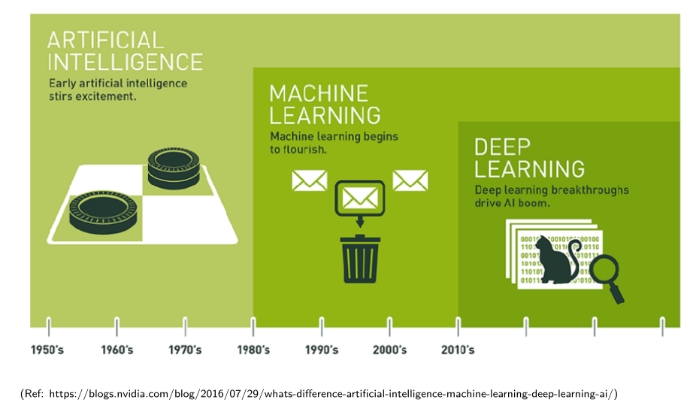
Relationship between AI, ML, DL

Slide 17
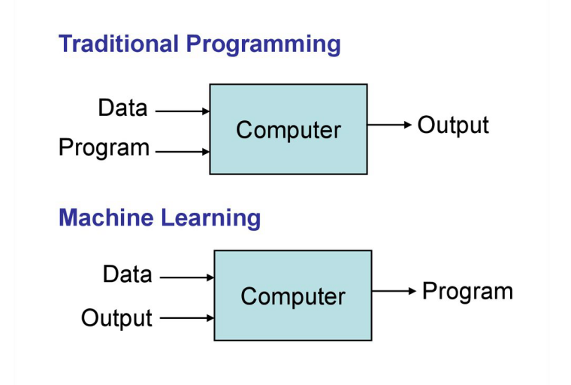
Traditional vs. Machine Learning?

Slide 18
Why Machine Learning?
Problems with High Dimensionality
Hard/Expensive to program manually
Techniques to model ‘ANY’ function given ‘ENOUGH’ data.
Job $$$

Slide 19
Why now?
Flood of data (Internet, IoT)
Increasing computational power
Easy/free availability of algorithms
Increasing support from industries

Slide 20
Preparing Career in Data Sciences
May be too early… well, may be not!!

Slide 21
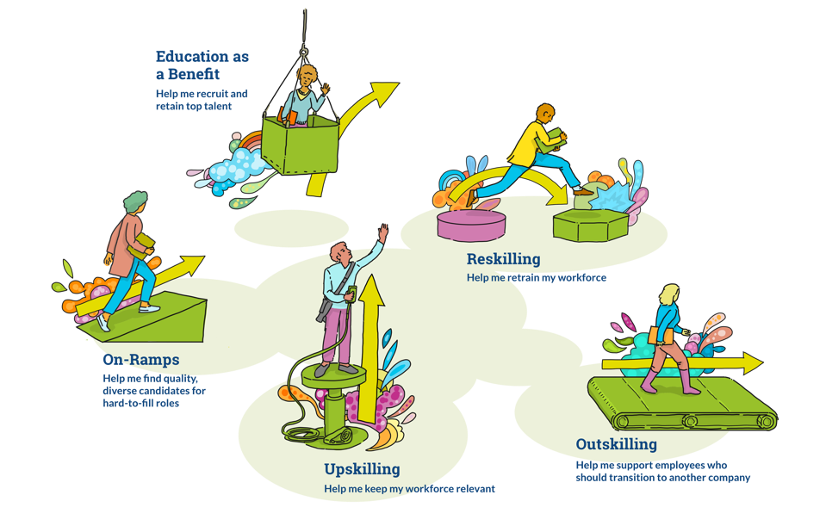
Current State
44% of US workforce < $18K/yr (< poverty line), works 80-100 hrs/week
Automation CAGR 7% (as per BCG), to reach $114B by 2025
Source: As Pressure To Upskill Grows, 5 Models Emerge – Forbs.com

Slide 22
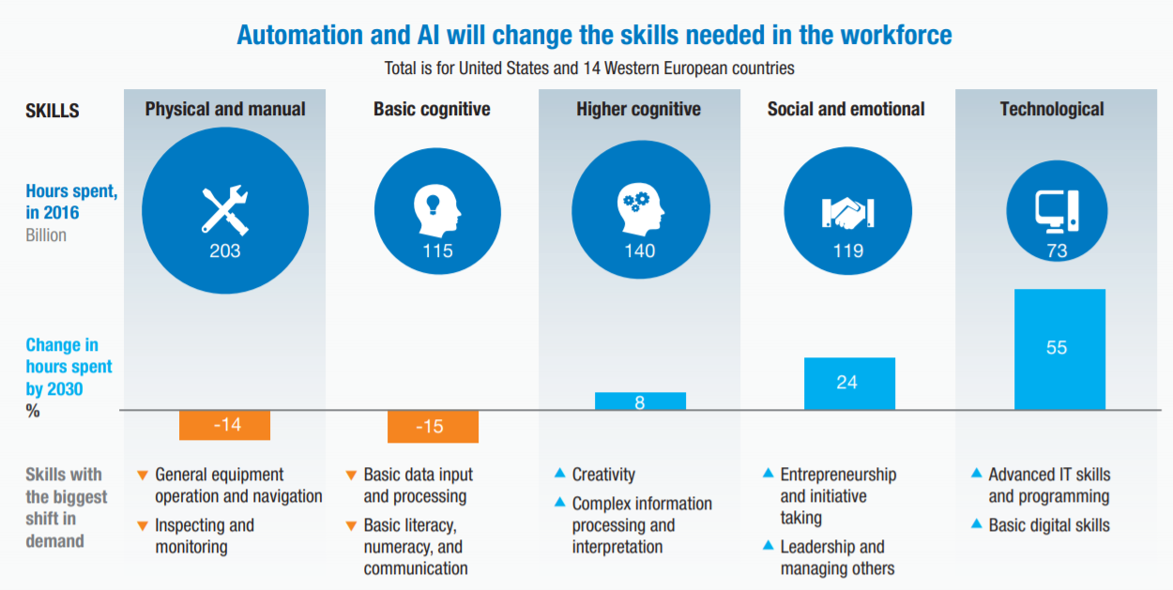
McKinsey Global Institute Report – Discussion Paper 2018

Slide 23
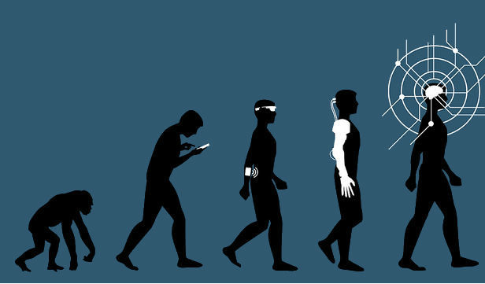
Examples
More Cognitive, Creative, Human
Software developers
Customer service representatives
General and operations managers
Human resources managers
Personal finance advisors
Psychologists
Artists
Sportsman
Researchers
Nurses, care
Less mechanical, automatable
Bill and account collectors
Data entry operators
Computer network support
Secretaries and administrative assistants
Insurance sales agents
Office clerks
Source: The Simplistic Debate Over Artificial Intelligence – Preston Estep

Slide 24
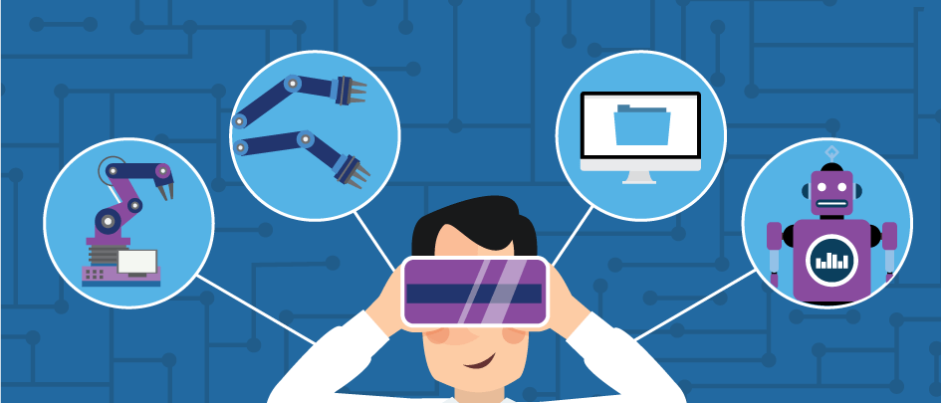
Changes
Technological
AI deluge
Digitization -> Data + APIs
Remote *
Source: Rise of the Chatbots: How AI Changed Customer Service – Salesforce.com
Social
Over interaction + isolation
Obsolete roles, emergence of new
Lifelong re-skilling
Financial
Widening gap
Flatter world
Gigs over jobs

Slide 25
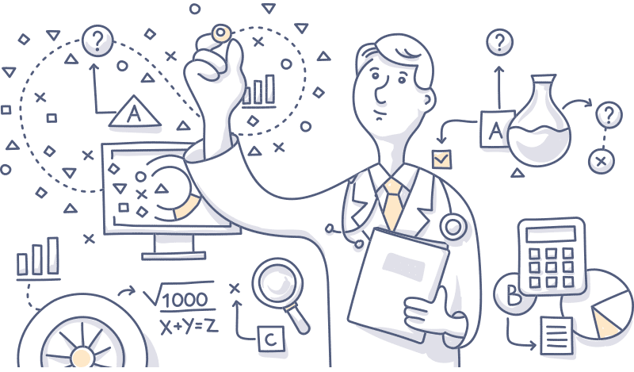
Examples
Technological
Medical: diagnostics, drug discovery, pharmaco-vigilance
Digitization -> Legal, Health records,
Jan Dhan-Aadhaar-Mobile Trinity
Social
e Governance, e Education, wider reach
Push due to COVID
No geo-restrictions for teachers, IT workers, lawyers…
Source: AI in healthcare – foreseemed.com

Slide 26
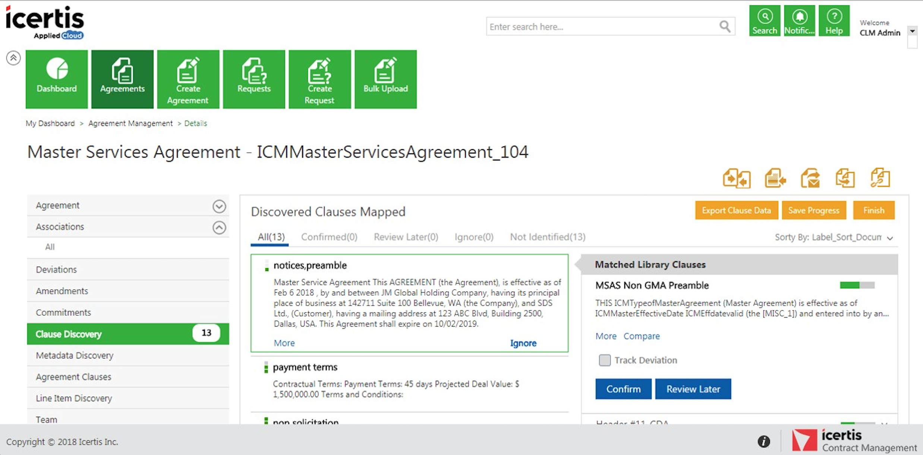
Examples

Slide 27
What got you here, won’t get you there!! - Marshal Goldsmith

Slide 28
How to prepare?

Slide 29
Well, you can’t prepare!! specifically…

Slide 30
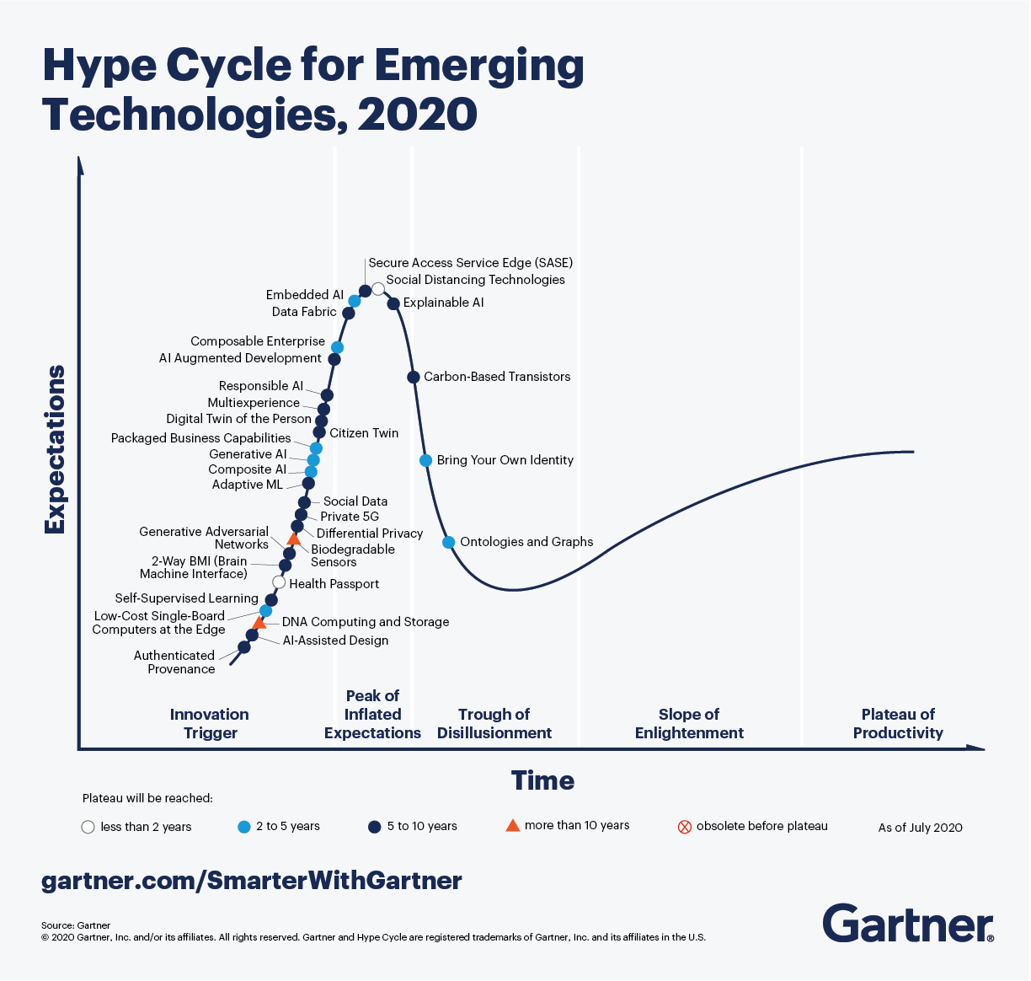
Upwinds

Slide 31
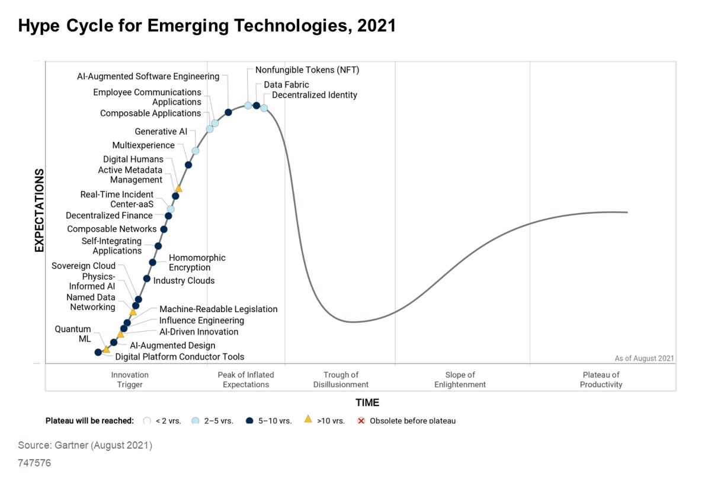

Slide 32
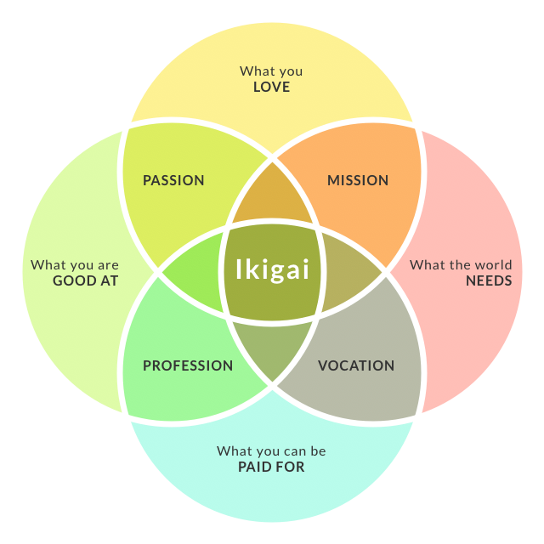
Ikigai
Source: How To Find Your Ikigai And Transform Your Outlook On Life And Business - Chris Myers

Slide 33

Generic Gyan
Specific Knowledge
Unique, rare combination
Un-trainable, un-scalable
Acquired thru apprenticeship
Leverage:
Permissioned: Capital, Labor
Un-permissioned: Content, code
Marginal cost of duplication
Own story:
Current jobs were not available 10 yrs back
Pick difficult problems/domain, Job, RnD
If not now, can change later, Mid career change, harder, but possible.
Wealth is a positive sum game

Slide 34
Thank You
yogeshkulkarni@yahoo.com

